Slide 1
Introduction to IBM Rational Synergy

Slide 2
Overview of Rational Synergy
Rational Synergy is task based software configuration management (SCM) solution that supports medium to large development teams working in heterogeneous, distributed computing environments.
It provides capabilities that help software and systems development teams work and collaborate faster and easier.
Helps software delivery teams to manage the complexity of global collaboration and boosts overall productivity.
Records information about projects, tasks, processes and the people associated with them.

Slide 3
Why Synergy
Increase Productivity while reducing cost of development and time to market
User friendly
Scalable team support
Ready to use process patterns
Integrated with Change for Change Requests and task based CM

Slide 4
Task Based Configuration Management (TBCM)
In IBM Rational Synergy everything is task based starting from top level projects to subprojects, directories and files.
All related changes are identified by tasks

Slide 5
Task Based Configuration Management
How it works?
Build Managers create a Project specific Release and tasks and publish it to the developers
The developers creates a copy of the Projects and start working on their assigned tasks
Developers create their tasks
Checks out the file
Make the required changes in the file
Completes the task – This will automatically check in the file and will help other developers also aware about the latest changes and thus saves time

Slide 6
Advantages of Task Based Configuration Management
Avoids manual check-ins
Clear priorities
Makes it simpler for developers to know what other developers are doing

Slide 7
Global Software and system development platform
Develops globally and manage centrally
Manage distributed software development through single repository
Increase Productivity and cost effectiveness

Slide 8
Advanced Baseline and Delivery
Synergy provides a clear understanding of what is in the delivery
Baseline comparison also helps to monitor changes and enhancements
Helps in gathering and understanding which change requests are partly or completely
included in the baseline

Slide 9
Component Based development support (CBD)
Synergy provides better CBD by:
Better controlling what component is published where
Component repository allows components to be uniquely identified
Establishing reuse mechanism
Monitoring feature interaction and testing prior to production build
Managing the process of component sharing

Slide 10
Advanced parallel development support
Why Parallel Development
Many teams may be working on one application:
Project requires large development resources
Project requires separate maintenance team for issue updates
One application may require many specific deliverables
For multiple Platforms (OS)
For multiple customers
For multiple native languages
Business Process
Changes needs to be segmented (New Features and Defects)

Slide 11
Parallel development in Synergy
Parallel Concurrent Development
Parallel Variant Development
Parallel Release Development
You receive warnings about parallel versions of members:
On check-out of a member
If our check-out creates a parallel version of the member
On check-in of a member or
When completing a task
If parallel versions of your member exists and
If the other member version is checked in and
If you are allowed to check in a parallel version to this new state

Slide 12
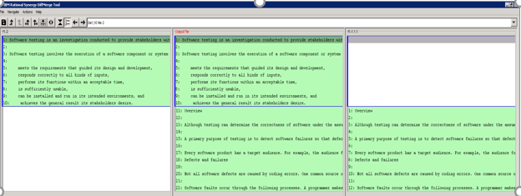
Parallel development in Synergy using Merge Tool
Middle merge file starts from an automatic merge
Review and update this automatic merge
Select LEFT line or
Select RIGHT line or
Merge BOTH
Edit the resulting line

Slide 13
Integration with Change Management System
Integrated life cycle change management through Rational Change
Rational Synergy and Rational Change share the same repository i.e Rational Synergy Database due to which
Information become more visible
Manageable
And available for up-to-date reporting and decision making
Provide developers a full context of their work
Provide project managers full visibility of ‘proposed change’ throughout life cycle

Slide 14
Advantages
Provides complete requirement to code traceability
Reduce developer’s management overhead through task based to-do list
No manual records keeping
Eliminates individual file check-ins, preventing future build problems
Powerful synchronizing mechanism, intelligent conflict detection prior to the
build , thus reducing the time and effort

